Slide 1
University of Diyala College of Engineering Dept. of Communications

Slide 2
“ Digital Communications “ By Haidar N. Al-Anbagi Lec (7) Time: (4 hrs) 2017

Slide 3
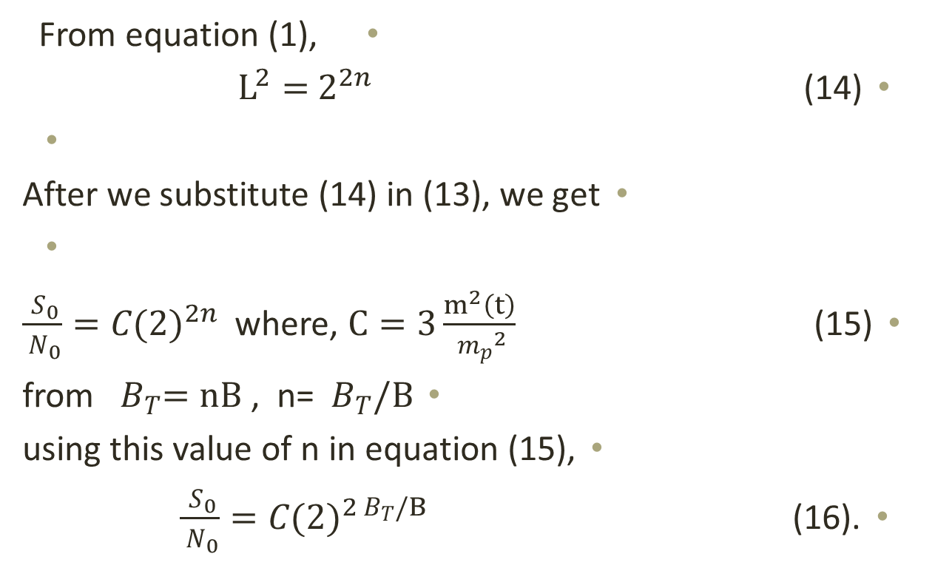
Exponential increase of the output SNR (SNR is directly proportional to BW)
From equation (1),
$L^{2}=$ $2^{2n}$ (14)
After we substitute (14) in (13), we get
$\frac{{ S}_{0}}{{ N}_{0}}=C{(2)}^{2n}$ where, $C=3\frac{m^{2}\left(t\right)}{{{ m}_{p}}^{2}}$ (15)
from ${ B}_{T}=nB$ , n= ${ B}_{T}/B$
using this value of n in equation (15),
$\frac{{ S}_{0}}{{ N}_{0}}=C{(2)}^{2{ B}_{T}/B}$ (16).

Slide 4
To calculate S/N in dB,
${ (\frac{{ S}_{0}}{{ N}_{0}} )}_{dB}=10 \log_{10}{\frac{{ S}_{0}}{{ N}_{0}}}$ = $10 \log_{10}{C{(2)}^{2n}}$
= 10 $\log_{10}{C+2n }\log_{10}2$
= (Alpha + 6n) dB (17)
Where, Alpha =10 $\log_{10}{C }$

Slide 5
Example:
A signal m(t) whose bandwidth is 4 KHz is transmitted using binary PCM. Compare the case of L=64 with the case of L=256 from their transmission bandwidth and the output S/N point of views. (Alpha=-8.51 dB)
Solution:
a) for L=64, n=6, then the transmission bandwidth= nB= 24 KHz
Therefore,
${ (\frac{{ S}_{0}}{{ N}_{0}} )}_{dB}=$ (Alpha + 6n) dB = -8.51+36 = 27.49 dB
b) for L=256, n=8, then the transmission bandwidth= nB= 32 KHz
Therefore,
${ (\frac{{ S}_{0}}{{ N}_{0}} )}_{dB}=$ (Alpha + 6n) dB = -8.51+48 = 39.49 dB
The difference is 12 dB !! while the second one needs only 33% more BW than the first one does.

Slide 6
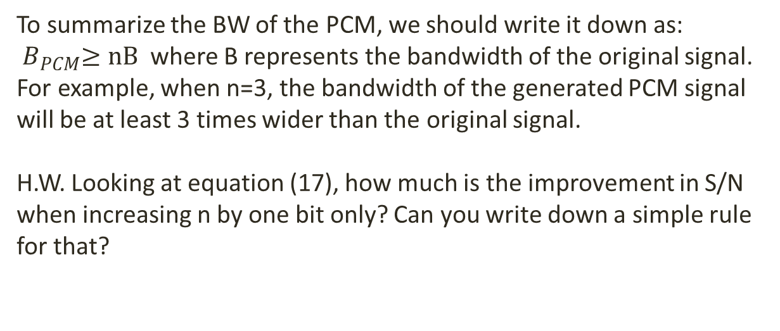
To summarize the BW of the PCM, we should write it down as:
${ B}_{PCM}≥nB$ where B represents the bandwidth of the original signal.
For example, when n=3, the bandwidth of the generated PCM signal will be at least 3 times wider than the original signal.
H.W. Looking at equation (17), how much is the improvement in S/N when increasing n by one bit only? Can you write down a simple rule for that?

Slide 7
Limitation of PCM:
For the purpose of audio and video transmission, PCM has been the most favored modulation scheme ever used. Some of the advantages of PCM can be summarized as follows:
1. Less vulnerable to get affected by noise and interferences.
2. Since it involves the transmission of binary pulses, it is easy to regenerate these pulses during the transmission path.
3. The flexibility of getting SNR improved when the B.W. is slightly increased.
4. TDM may be used to time multiplex PCM signal from different sources.
5. Encryption and decryption can be involved to secure data being transmitted using PCM scheme.
On the other hand, PCM has come up with mainly two disadvantages, implementation complexity and the expansion of transmission B.W. The first one is no longer a big issue due to the availability of very large scale integrated (VLSI) circuits. These chips are available to implement PCM in a simple way. The second disadvantage is the transmission bandwidth of PCM. Obviously, the B.W. of PCM is much wider than the original signal B.W.

Slide 8
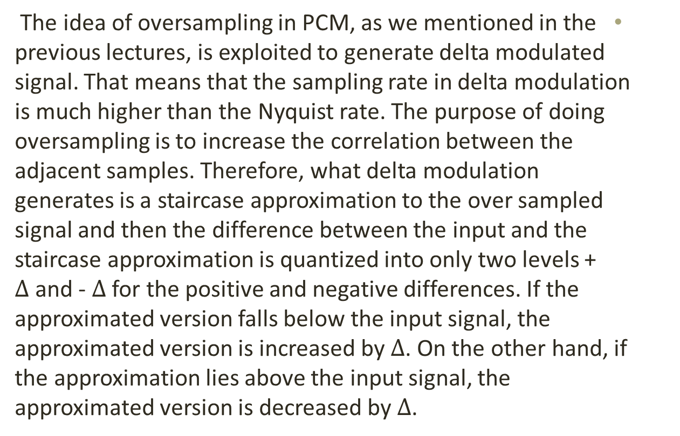
Delta Modulation
The idea of oversampling in PCM, as we mentioned in the previous lectures, is exploited to generate delta modulated signal. That means that the sampling rate in delta modulation is much higher than the Nyquist rate. The purpose of doing oversampling is to increase the correlation between the adjacent samples. Therefore, what delta modulation generates is a staircase approximation to the over sampled signal and then the difference between the input and the staircase approximation is quantized into only two levels + $∆$and - $∆$ for the positive and negative differences. If the approximated version falls below the input signal, the approximated version is increased by $∆$. On the other hand, if the approximation lies above the input signal, the approximated version is decreased by $∆$.

Slide 9
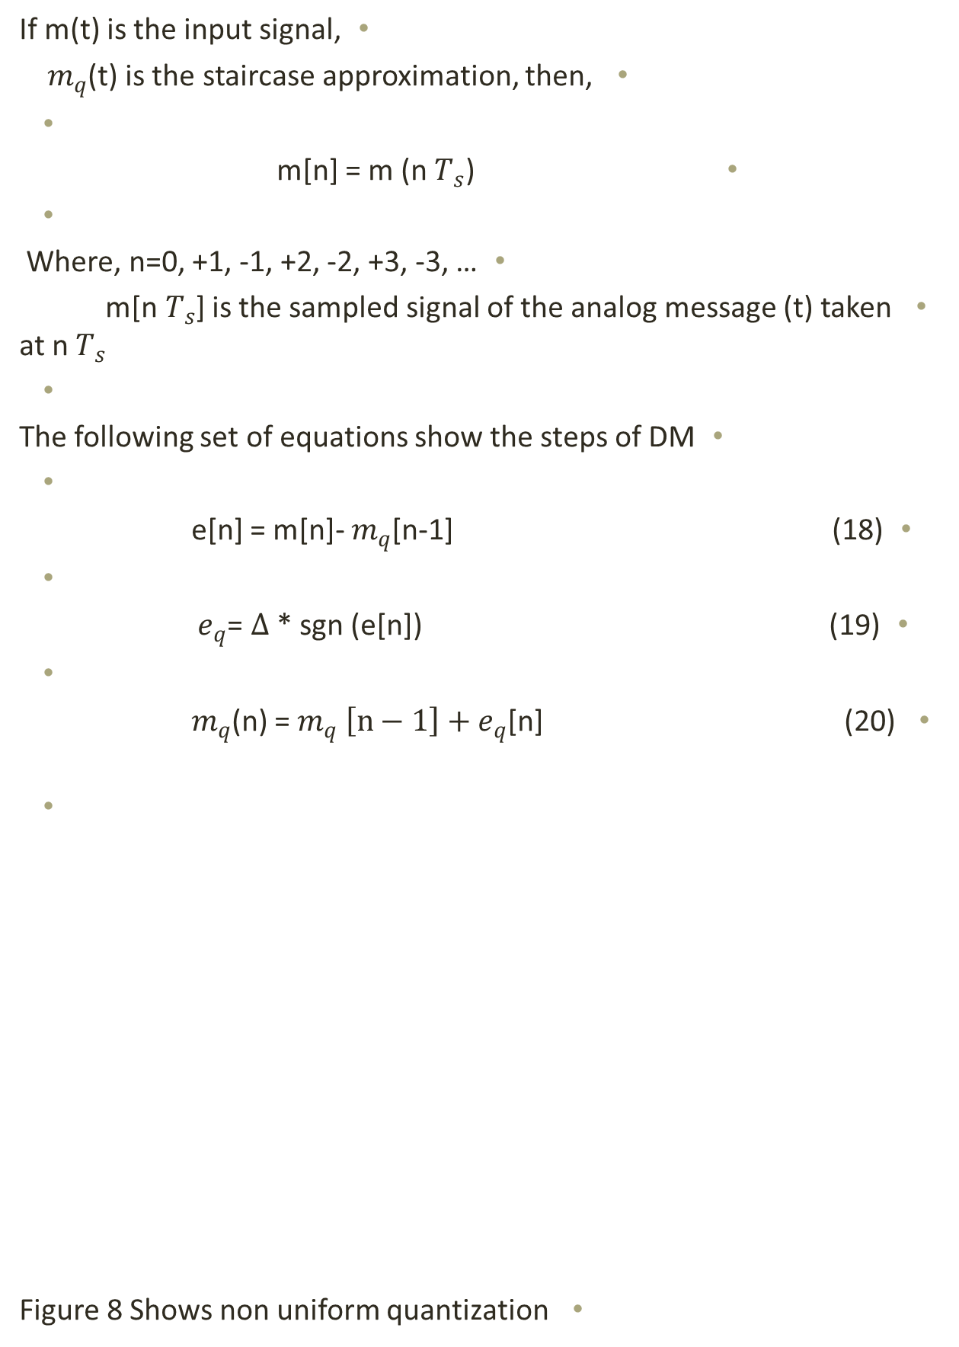
If m(t) is the input signal,
${ m}_{q}$(t) is the staircase approximation, then,
m[n] = m (n${ T}_{s}$)
Where, n=0, +1, -1, +2, -2, +3, -3, …
m[n${ T}_{s}$] is the sampled signal of the analog message (t) taken at n${ T}_{s}$
The following set of equations show the steps of DM
e[n] = m[n]- $m_{q}$[n-1] (18)
$e_{q}$= $∆$ * sgn (e[n]) (19)
$m_{q}$(n) = $m_{q} \left[n−1\right]+e_{q}$[n] (20)
Figure 8 Shows non uniform quantization

Slide 10
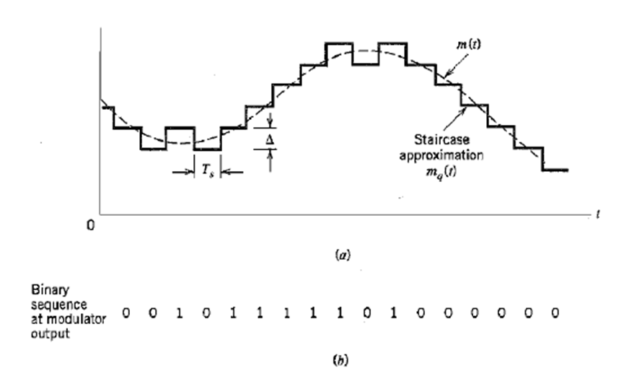
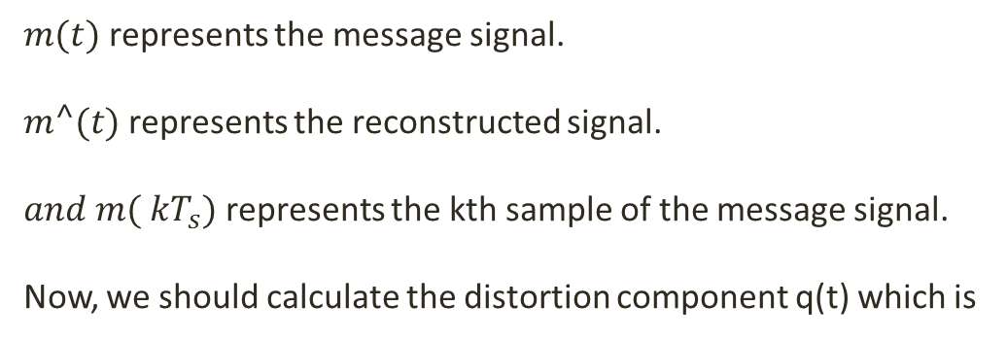
$m(t)$ represents the message signal.
$m⌃(t)$ represents the reconstructed signal.
$and m({ kT}_{s})$ represents the kth sample of the message signal.
Now, we should calculate the distortion component q(t) which is
Figure (1) Shows the procedure of DM

Slide 11
$q(t)=\sum_{k}{[m⌃\left({ kT}_{s}\right)−m\left({ kT}_{s}\right)]}sinc(2πBt−kπ$ (6)
$q(t)=\sum_{k}{q\left({ kT}_{s}\right)}sinc(2πBt−kπ)\text{ (}\text{7}\text{)}$
$\text{Where}\text{, }$
$\text{q}\text{(}\text{t}\text{) = }\text{Unwanted} \text{signal}\text{ (}\text{i}\text{.}\text{e}\text{. }\text{noise} \text{signal}\text{) }\text{caused} \text{by} \text{the} \text{quantizer}\text{. }$
$\text{Hence}\text{, }\text{it} \text{is} \text{called} \text{quantization} \text{noise}\text{. }$
$\text{To} \text{get} \text{the} \text{power} \text{of} \text{the} \text{quantization} \text{noise}\text{, }\text{we} \text{apply}\text{:}$
$\underset{T→∞}{q^{2}(t)=lim}{1/T}\int_{−T/2}^{T/2}{q^{2}(t)} dt \text{(}\text{8}\text{)}$
$\text{ = }\lim_{T→∞}{1/T}\int_{−T/2}^{T/2}{{[\sum_{k}{q\left({ kT}_{s}\right)}sinc(2πBt−kπ)]}^{2}} dt \text{(}\text{9}\text{)}$

Slide 12
The main advantage of DM is the implementation simplicity since it represents each level using only one bit. The block diagram of DM is shown in figure (2). DM has three main parts or procedures, comparator, quantizer, and accumulator. The comparator computes the difference between the two inputs, m[n] and $m_{q}[n−1]$. The quantizer has an output which is scaled version of signum function which produces either -$∆$ or +$∆$ as we explained. Finally, the quantizer output is applied to the accumulator to find out the value of the present value based on the previous values.

Slide 13
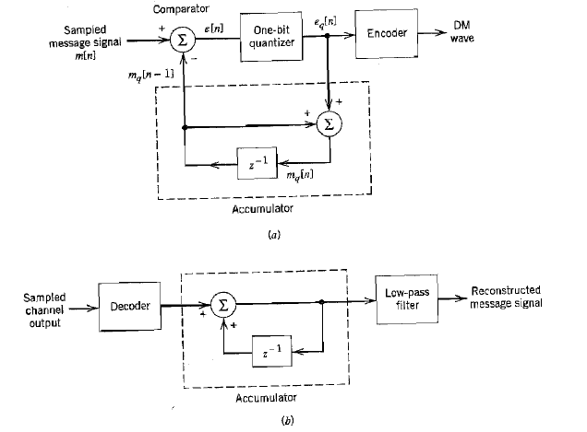
Figure (2) DM modulator and demodulator

